Slide 1
Development Tooling Update

Slide 2
Providing Powerful, but Simplified RAD – RAD-AD
A subset of IBM Rational Application Developer for WebSphere is included in WAS V7 and called IBM Rational Application Developer Assembly and Deploy Features for WebSphere (RAD-AD).
IBM Rational Application Developer Assembly and Deploy Features for WebSphere is fully licensed and supported with the WAS license.
Remaining content is optionally installable as a 60-day trial and becomes perpetually licensed on purchase of RAD for Websphere or priced modules

Slide 3
Providing Powerful, but Simplified RAD – RAD-AD
Rational Application Developer plugins
(not included in RAD-AD)
WebSphere
plugins
Eclipse.org

Slide 4
RAD vs RAD-AD feature comparison
RAD for WebSphere
Programming model tools:
EJB3 productivity features
Domain modeling (visual edit)
  Java, EJB, XSD, WSDL, Data
Web Development (visual edit)
Web Services productivity features
Portlet JSR
Relational Data Tools
Miscellaneous:
XML productivity features
Extra Debuggers (XSLT, stored procedures…)
WAS Test servers: v6.0, v6.1, v7.0
WAS n-2 support
J2C
  CICS and IMS Adapters
Licensed but supplied separately:
  RequisitePro integration
  RUP
  IBM Support Assistant
More…
  RAD Assembly & Deploy
  Profile Management tools
  Jython Tools
  J2EE 1.4 (same level as AST 6.1)
  JEE5 XML-form based DD editors
  JEE5 application support
  WAS 7 support only
  WAS debug extensions
  Application Deployment Support (WAS 7.0)
  SIP
EIS Adapters
SAP, Siebel, JDE, Oracle, PeopleSoft
Portal (Lotus)
Portal Tools
SCA (Post v7.5)
SCA 1 (Public)
Notes:
Page <number> of 14
*IBM Confidential*
IBM Software Group

Slide 5
Hot news from Impact 2009 in Las Vegas...
WebSphere Application Server for Developers
is now
free of charge
Add WAS 4 Developers to your RAD-AD and you have a free of charge development environment for all your WebSphere developers, with a real WAS test environment
WAS for Developers support available for purchase.

Slide 6

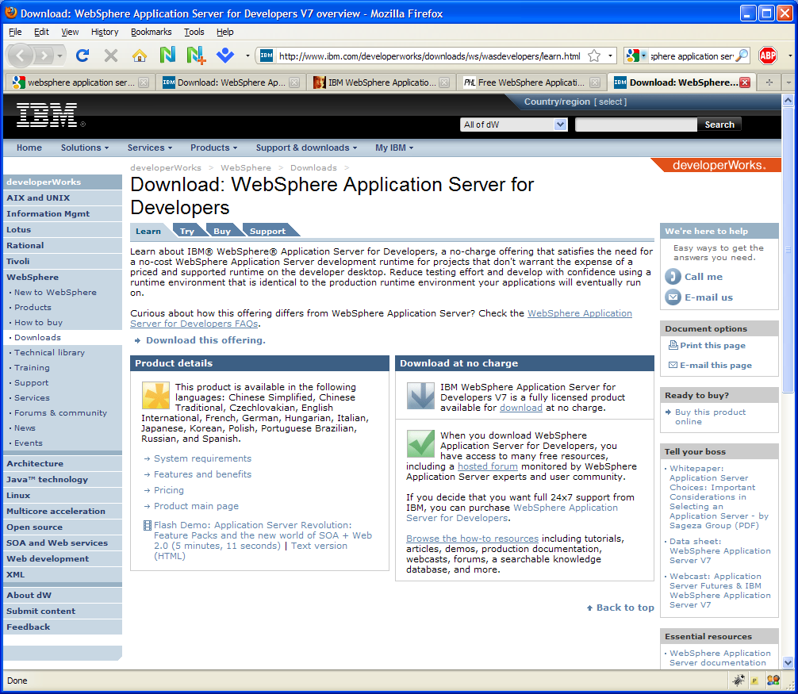
Getting your own free of charge development environment
IBM developerWorks
WAS4Dev free download
WAS licenses
in production
includes RAD-AD
license
www.ibm.com/developerworks/downloads/ws/wasdevelopers
RAD-AD
WAS4Dev
Developers PCs
(unlimited number)
Notes:
WAS 4 Dev: http://www.ibm.com/developerworks/downloads/ws/wasdevelopers/learn.html

Slide 7
What does this mean?
Develop – Test – Deploy on the same WAS codebase
- Same codebase – same behaviour
- Maintain a single codebase of your own application
- Discover problems early in the test cycle
- Same fixpacks in development as in production
(allows you to reproduce the bugs on developers PCs)
Lighter Eclipse environment
- Less plugins improves performance
Supported by IBM
- Should you have any problem with the software, report it to IBM to get it fixed
(RAD-AD supported via WAS licenses, WAS 4 Dev support can be purchased separately if wanted)

